Slide 1

School of Mechanical Engineering and Automation
Lecture 4 Motion Models
Dr. Chen Haoyao
hychen5@hitsz.edu.cn

Slide 2
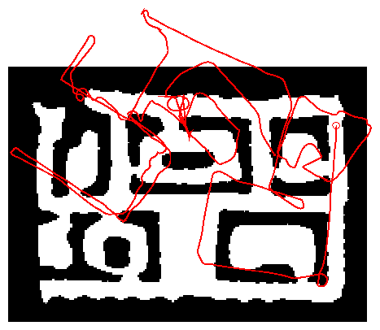
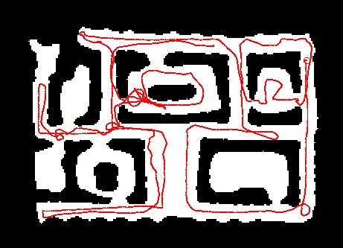
Robot Motion
Chapter 5
Linear
Robot motion is inherently uncertain.
How can we model this uncertainty?
Nonlinear

Slide 3
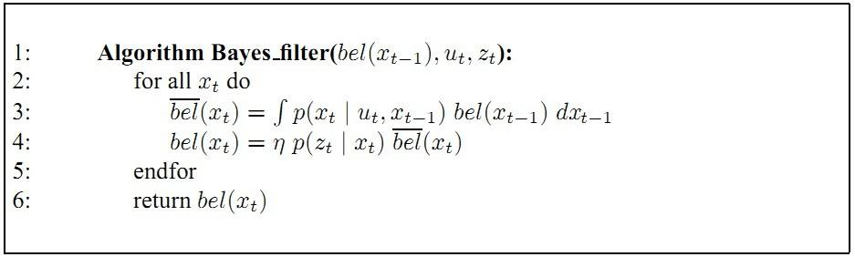
Dynamic Bayesian Network for Controls, States, and Sensations
Chapter 5

Slide 4
Probabilistic Motion Models
Chapter 5
To implement the Bayes Filter, we need the transition model p(x_{t} | x_{t-1}, u).
The term p(x_{t} | x_{t-1}, u) specifies a posterior probability, that action u carries the robot from x_{t-1} to x_{t}.
In this section we will specify, how p(x_{t} | x_{t-1}, u) can be modeled based on the motion equations.

Slide 5
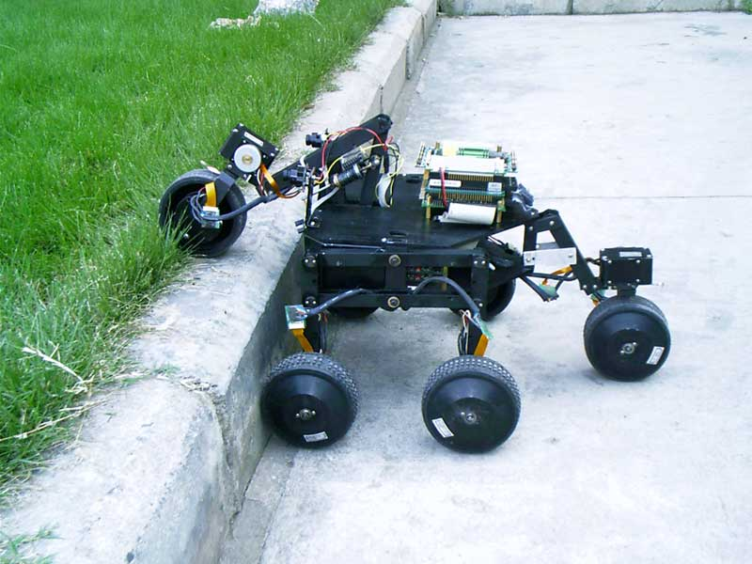
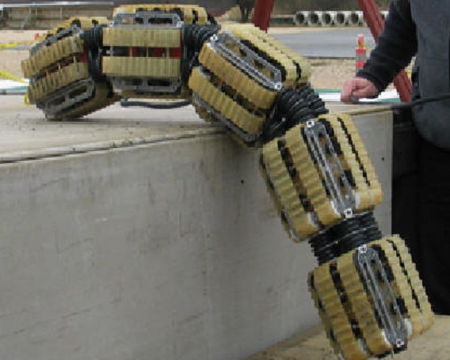
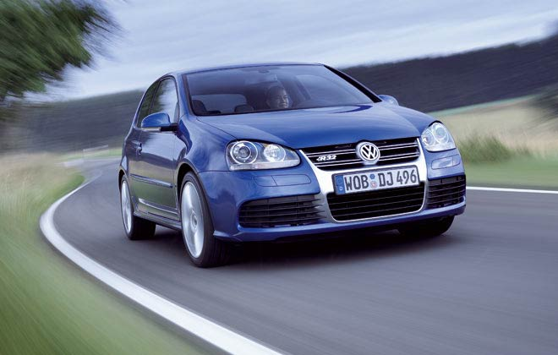
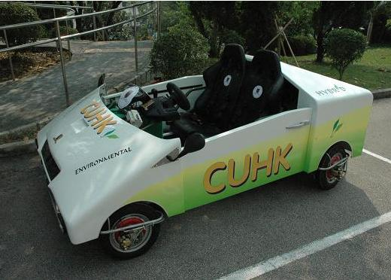
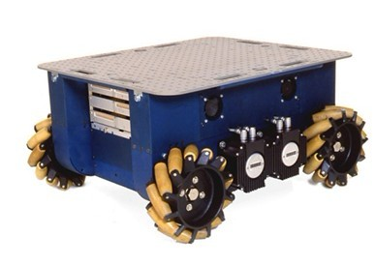
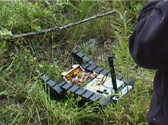
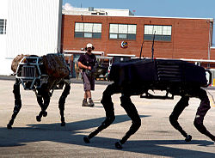
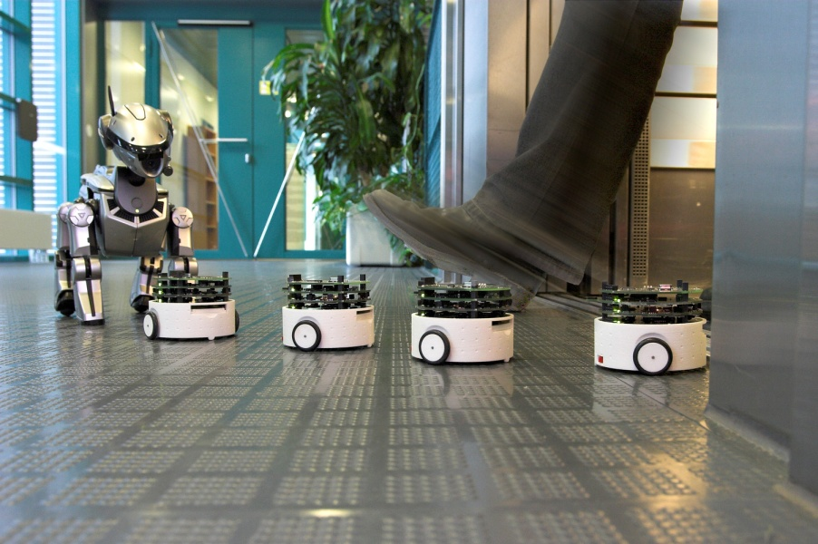
Mobile Robots
Chapter 5

Slide 6
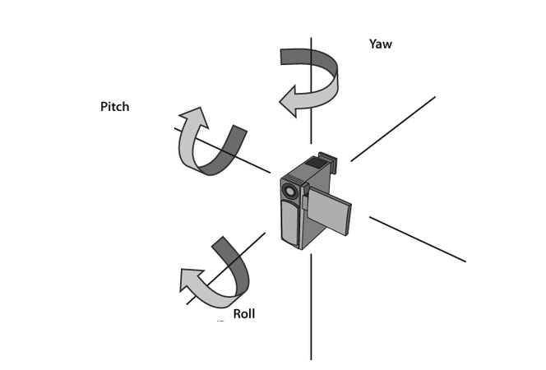
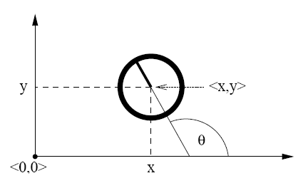
Coordinate Systems
Chapter 5
In general the configuration of a robot can be described by six parameters.
Three-dimensional cartesian coordinates plus three Euler angles pitch, roll, and yaw.
Throughout this section, we consider robots operating on a planar surface.
The state space of such systems is three-dimensional (x,y,θ).

Slide 7
Focused Robot
Chapter 5
Mobile Robots in planar environment
example 1
example 2
example 3

Slide 8
Typical Motion Models
Chapter 5
In practice, one often finds two types of motion models:
Odometry-based
Velocity-based (dead reckoning)
Odometry-based models are used when systems are equipped with wheel encoders.
Velocity-based models have to be applied when no wheel encoders are given.
They calculate the new pose based on the velocities and the time elapsed.

Slide 9
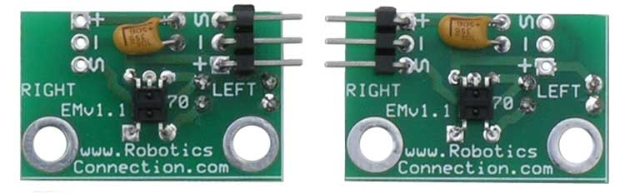
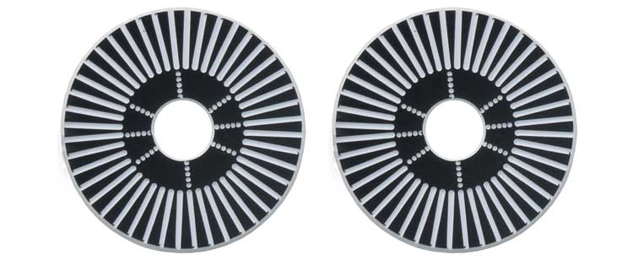
Example Wheel Encoders
Chapter 5
These modules require +5V and GND to power them, and provide a 0 to 5V output. They provide +5V output when they "see" white, and a 0V output when they "see" black.
These disks are manufactured out of high quality to offer a very crisp black to white transition. This enables a wheel encoder sensor to easily see the transitions.
Source: http://www.active-robots.com/

Slide 10

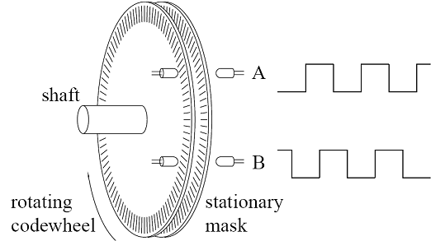
Example Wheel Encoders
Chapter 5
Source: http://www.active-robots.com/

Slide 11
Dead Reckoning
Chapter 5
Derived from “deduced reckoning.”
Mathematical procedure for determining the present location of a vehicle.
Achieved by calculating the current pose of the vehicle based on its velocities and the time elapsed.

Slide 12
Reasons for Motion Errors
Chapter 5
different wheel diameters
ideal case
bump
carpet
and many more …

Slide 13
Odometry Model
Chapter 5
Robot moves from to .
Odometry information .

Slide 14
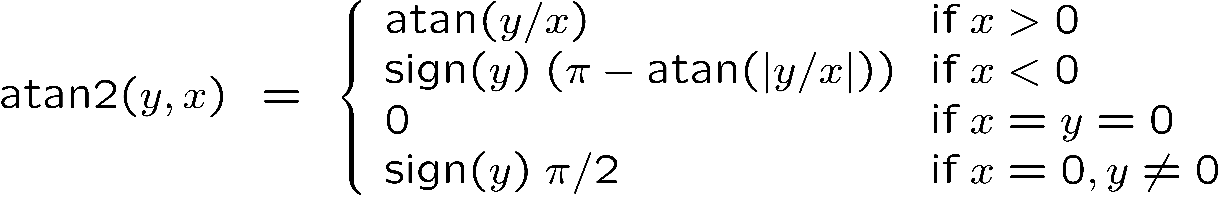
The atan2 Function
Chapter 5
Extends the inverse tangent and correctly copes with the signs of x and y.

Slide 15
Noise Model for Odometry
Chapter 5
The measured motion is given by the true motion corrupted with noise.

Slide 16
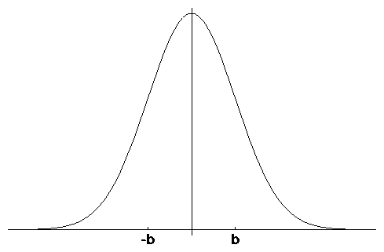
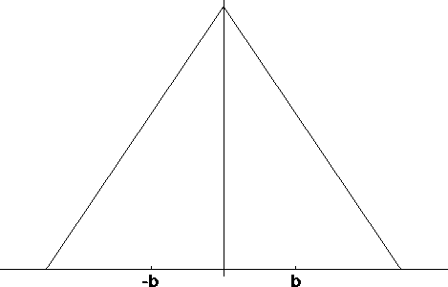
Typical Distributions for Probabilistic Motion Models
Normal distribution
Triangular distribution

Slide 17
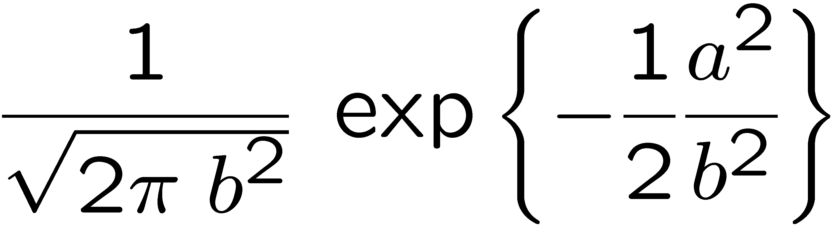
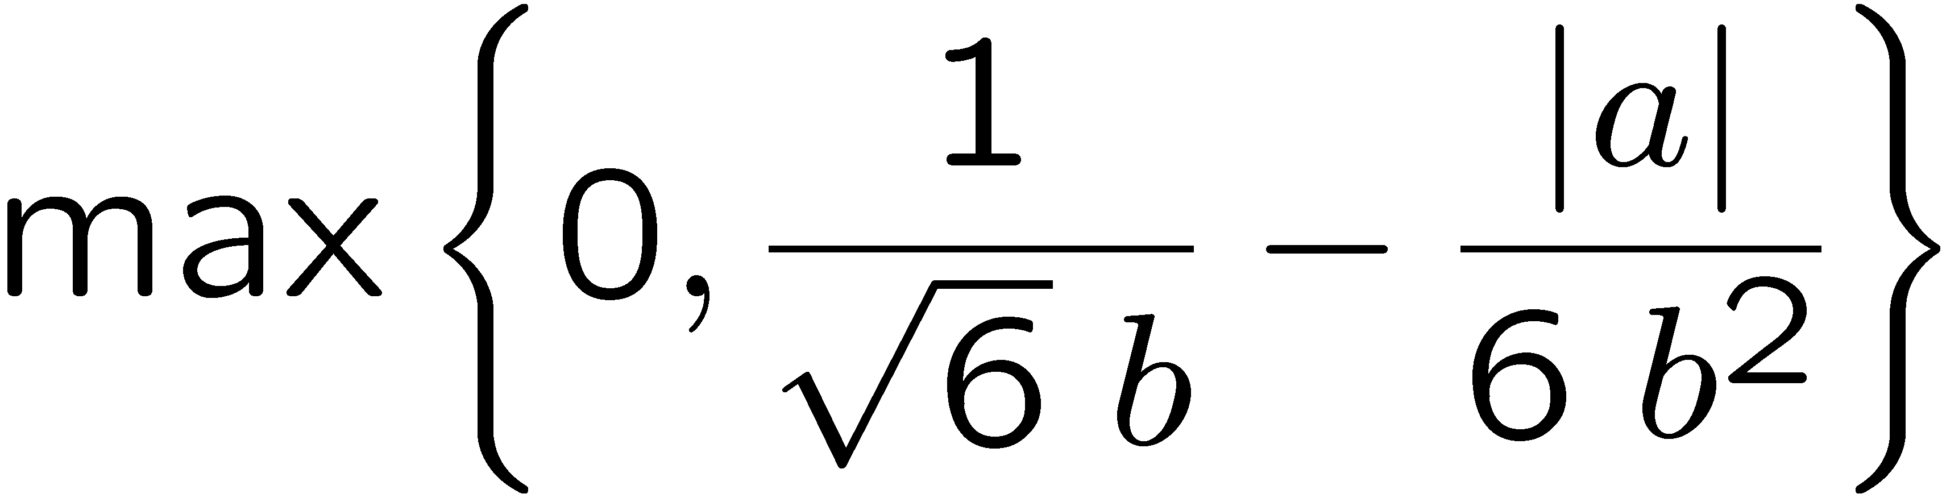
Calculating the Probability (zero-centered)
Chapter 5
For a normal distribution
For a triangular distribution
Algorithm prob_normal_distribution(a,b):
return
Algorithm prob_triangular_distribution(a,b):
return

Slide 18
Calculating the Posterior Given x_{t}, x_{t-1}, and u
An initial pose X_{t-1}
A hypothesized final pose X_{t}
A pair of poses u obtained from odometry
Algorithm motion_model_odometry (x_{t}, x_{t-1}, u)
return p₁ · p₂ · p₃
odometry values (u)
values of interest (x_{t-1}, x_{t})
Implements an error distribution over a with zero mean and standard deviation b

Slide 19
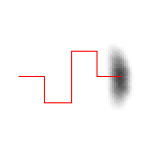

Application
Typical banana-shaped distributions obtained for 2d-projection of 3d posterior.
p(x_{t}| u, x_{t-1})
x
x
u
u
Posterior distributions of the robot’s pose upon executing the motion command illustrated by the solid line. The darker a location, the more likely it is.

Slide 20
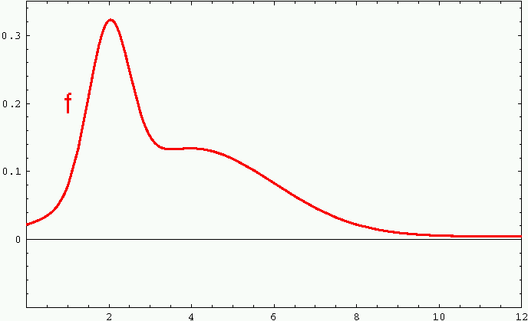
Sample-based Density Representation
Chapter 5

Slide 21
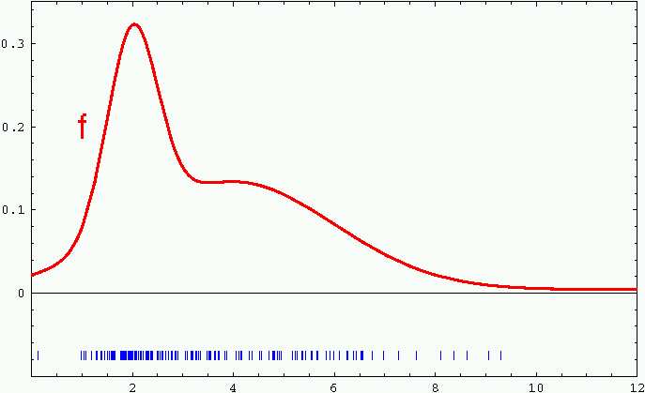
Sample-based Density Representation
Chapter 5

Slide 22
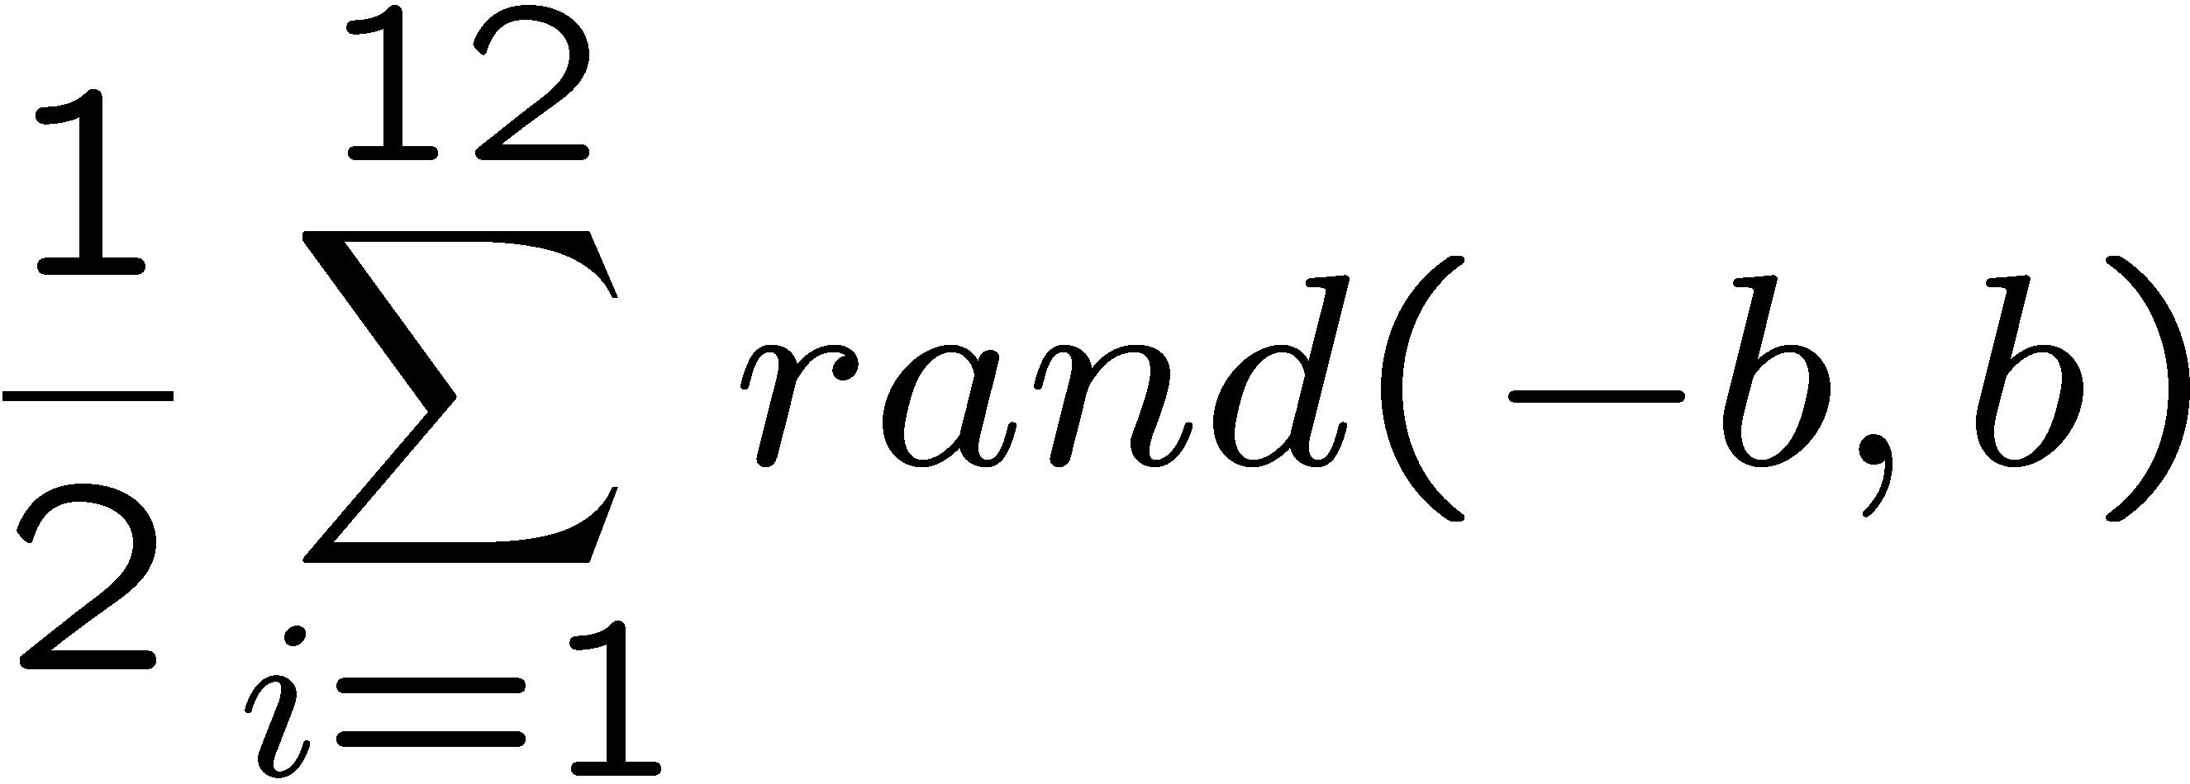
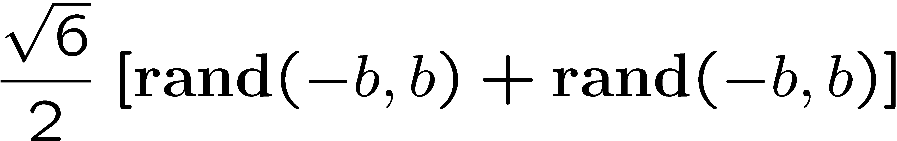
How to Sample from Normal or Triangular Distributions?
Chapter 5
Sampling from a normal distribution
Sampling from a triangular distribution
Algorithm sample_normal_distribution(b):
return
Algorithm sample_triangular_distribution(b):
return

Slide 23
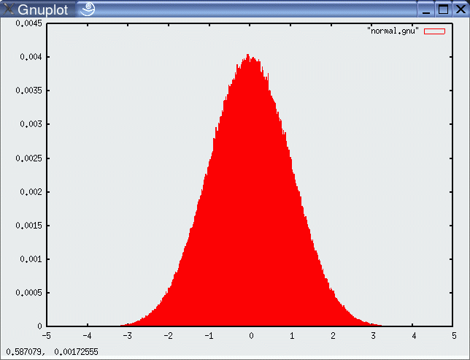
Normally Distributed Samples
Chapter 5
10⁶ samples

Slide 24
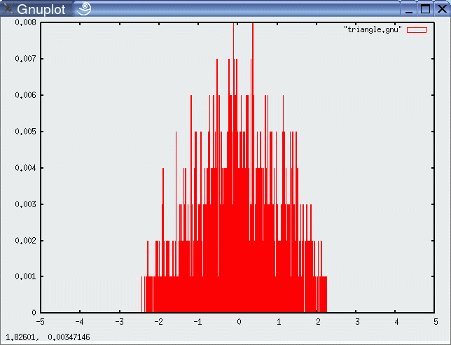
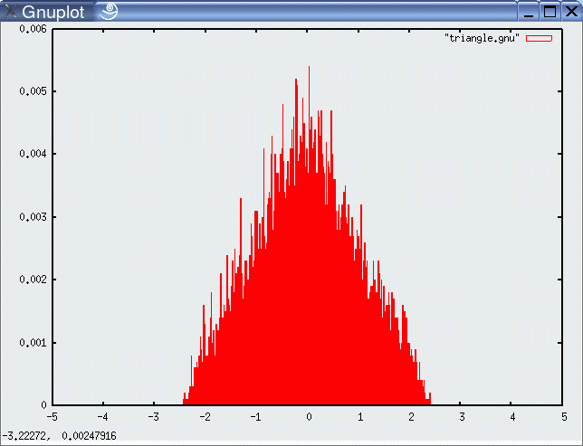
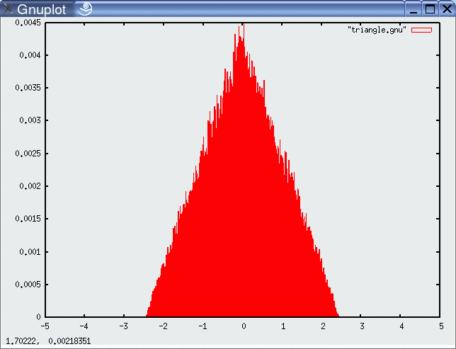
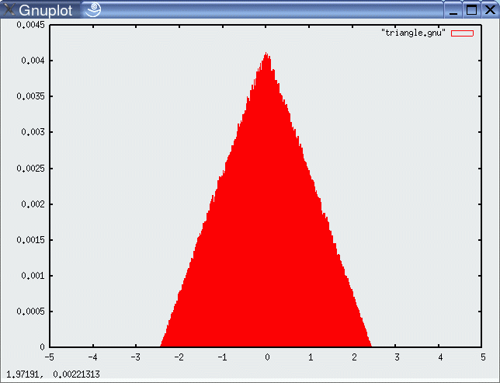
For Triangular Distribution
Chapter 5
10³ samples
10⁴ samples
10⁵ samples
10⁶ samples

Slide 25
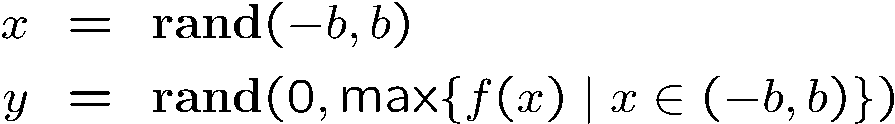
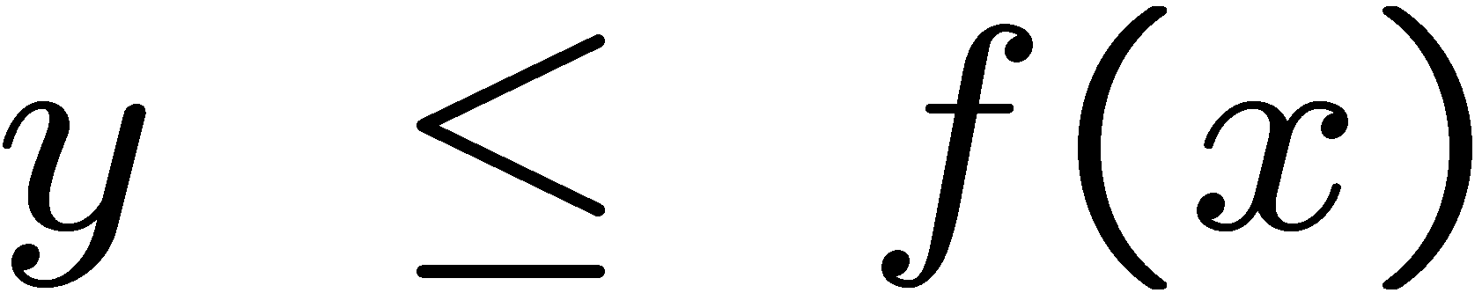

Rejection Sampling
Chapter 5
Sampling from arbitrary distributions
Algorithm sample_distribution(f,b):
repeat
until ( )
return

Slide 26
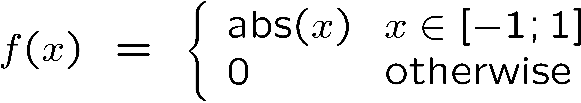
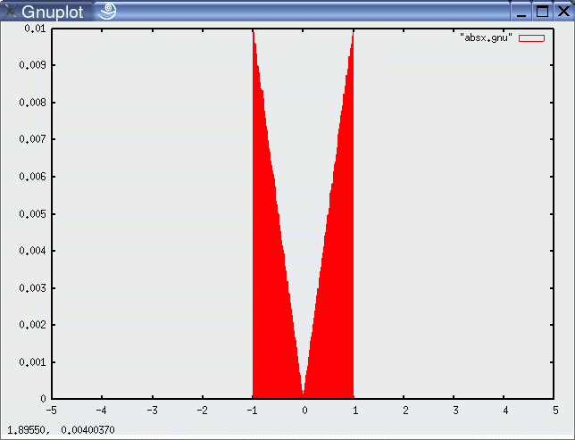
Example
Chapter 5
Sampling from

Slide 27
Sample Odometry Motion Model
Chapter 5
Algorithm sample_motion_model(u, x):
Return
sample_normal_distribution

Slide 28
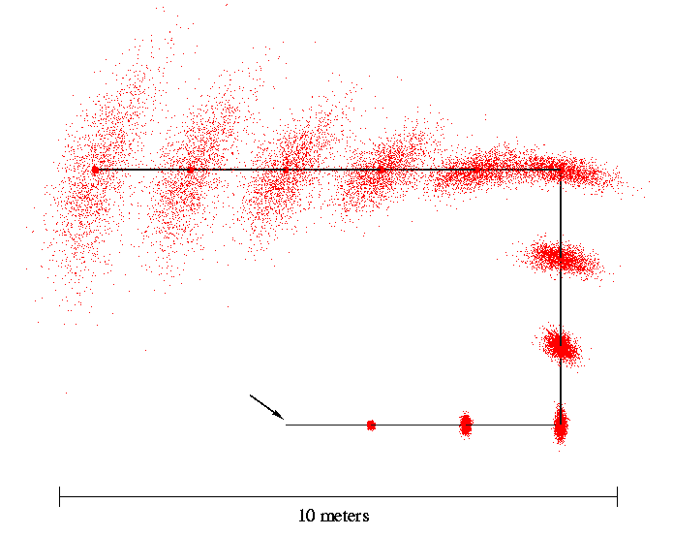
Sampling from Our Motion Model
Chapter 5
Start

Slide 29
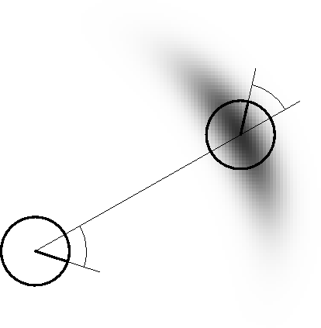
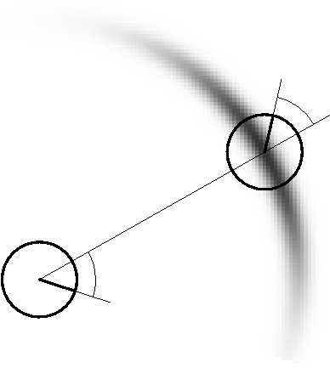
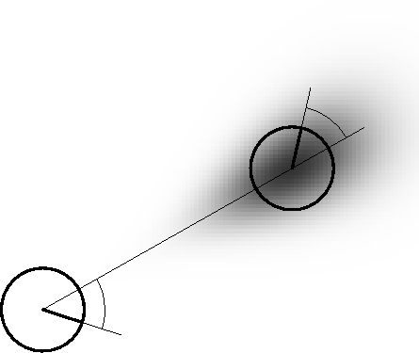
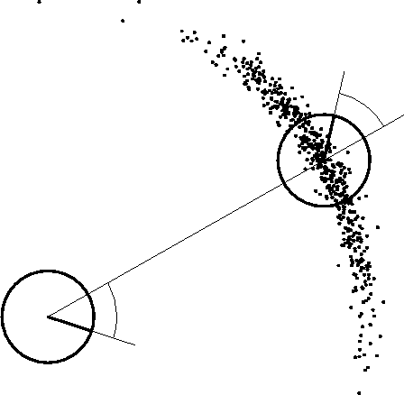
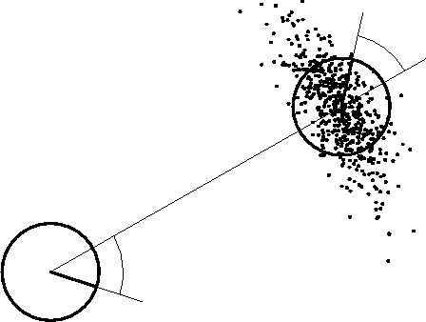
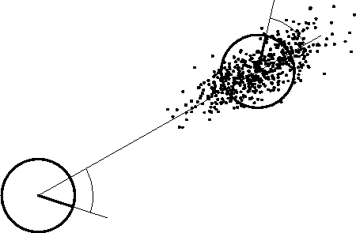
Examples (Odometry-Based)
Chapter 5

Slide 30
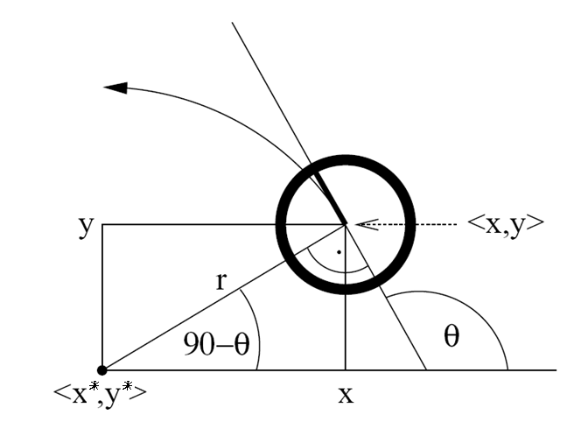
Velocity-Based Model
Chapter 5
Rotation radius
control

Slide 31
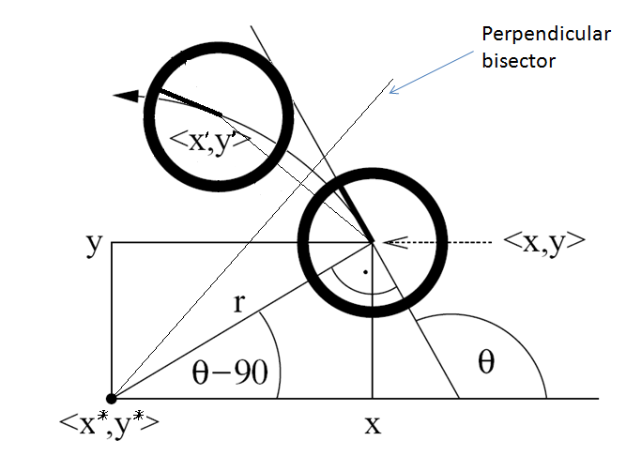
Equation for the Velocity Model
Instantaneous center of curvature (ICC) at (x_{c} , y_{c})
Initial pose
Keeping constant speed, after ∆t time interval, ideal robot will be at

Slide 32
Velocity-based Motion Model
With and are the state vectors at time t-1 and t respectively
The true motion is described by a translation velocity and a rotational velocity
Motion Control with additive Gaussian noise
Circular motion assumption leads to degeneracy ,
2 noise variables v and w ➔ 3D pose
Assume robot rotates when arrives at its final pose

Slide 33
Velocity-based Motion Model
Motion Model:
α₁ to α₄ are robot-specific error parameters determining the velocity control noise
α₅ and α₆ are robot-specific error parameters determining the standard deviation of the additional rotational noise

Slide 34

Probabilistic Motion Model
How to compute ?
Move with a fixed velocity during ∆t resulting in a circular trajectory from to
Center of circle:
with
Radius of the circle:
Change of heading direction:
(angle of the final rotation)

Slide 35
Posterior Probability for Velocity Model
Center of circle
Radius of the circle
Change of heading direction
Motion error: v_{err} ,w_{err} and

Slide 36
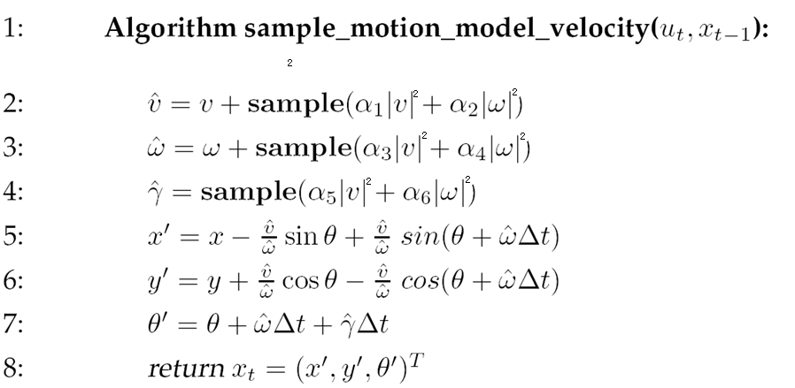
Sampling from Velocity Model
Chapter 5

Slide 37
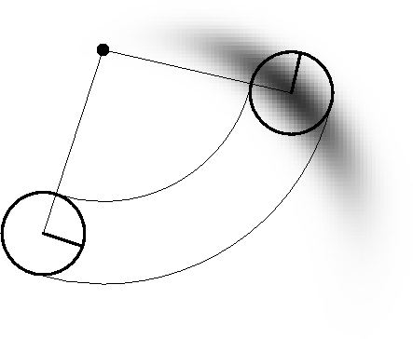
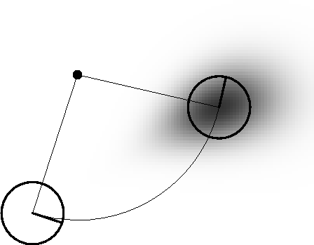
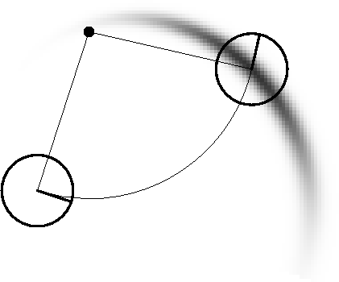
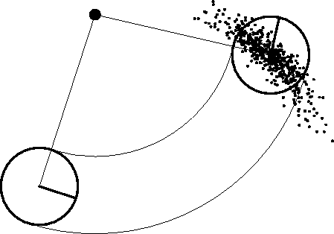
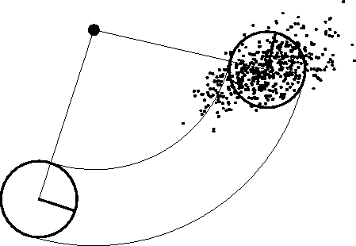

Examples (velocity based)
Chapter 5

Slide 38

Map-Consistent Motion Model
Chapter 5
≠
Approximation:

Slide 39


Map-Consistent Motion Model
Chapter 5
Approximation:

Slide 40

Summary
Chapter 5
We discussed motion models for odometry-based and velocity-based systems
We discussed ways to calculate the posterior probability p(x| x’, u).
We also described how to sample from p(x| x’, u).
Typically the calculations are done in fixed time intervals Δt.
In practice, the parameters of the models have to be learned.
We also discussed an extended motion model that takes the map into account.

Slide 41
Homework
Chapter 5
Optional: Page 145, Chapter 5, Exercises 1

